Slide 1
Dr. SHEEBA. S., ASSISTANT PROFESSOR, DEPT OF OBG

Slide 9
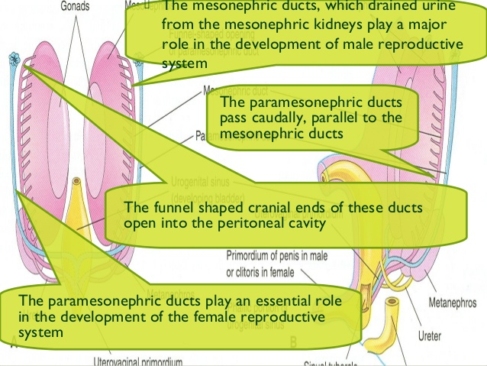

Slide 11
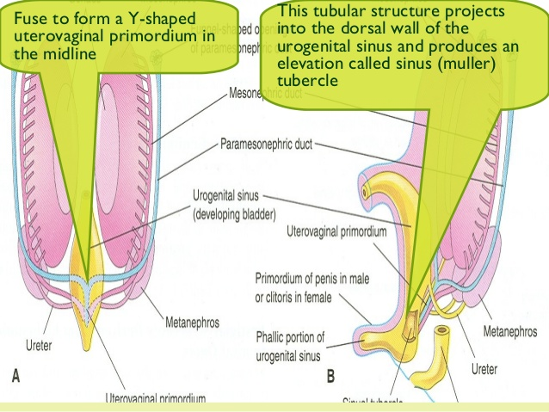

Slide 17
